Slide 1
Ecommerce Application
Presented by: Shubhangi zagade
Employee id: 46235110
Sprint 1 presentation
Guide by : vikas varma Batch :3

Slide 2
Contents cover
Application Information
Application Methods
Activity Diagram
Used software
Introduction of Angular
Introduction of Api
Flow of Application
Practical Interaction

Slide 3
Application Information
Try Create an web app in angular using api in DOT NET & database in Sql server.
In that application User can see the products & add the product on his card by logging and registering in Ecommerce app.
Where , Admin can see all products , register Users & Categories of the products.

Slide 4
Application Interaction Methods
Registration : It is simple registration process By filling necessary information user can register in account.
Logging : After registration through the logging user can go through account.
Dashboard : This is admin handler part . Through that Admin can see the list of Users , products & product categories.
Home : show the new updates and app info.
Account : its User account in that they can see the products
Add to card : user can add the product to their respective card.
Logout : close the account.

Slide 5
Activity Diagram
Start
User
Admin
Registration
Login
Login
Dashboard
Home
Logout
show User
Show product
Account
Show categories
Add to card

Slide 6

Used software
Visual studio code 2019
Visual studio code
Microsoft sql server management

Slide 7
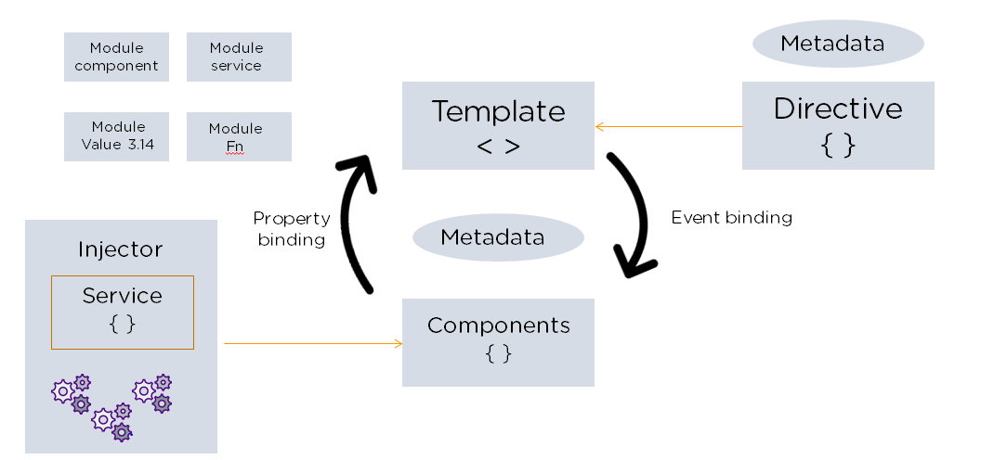
Introduction of Angular

Slide 8
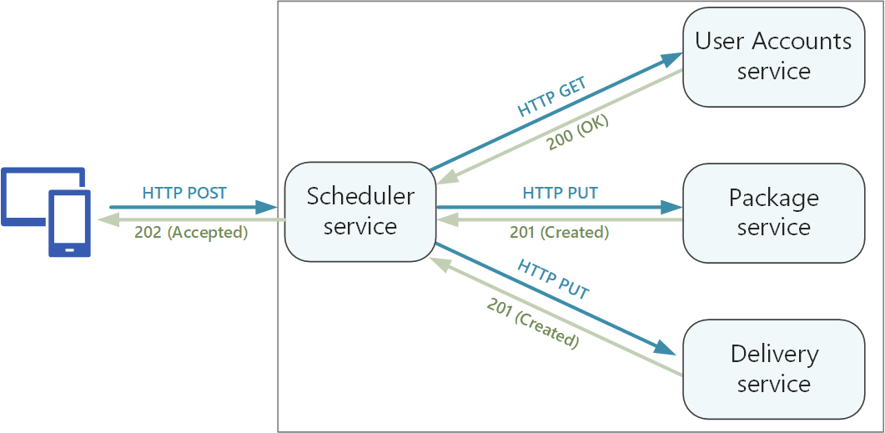
Introduction of Api

Slide 9
Flow of Application
SQL
SQL server
Create backend Database to store the resources in tubular form.
API
Asp .Net WEB-Api
Create scheduler services (Get ,Post..ect Methods) generate Http url. This url help to connect database.
Angular
Angular
Created frontend Web Application which interact with database through Api services.

Slide 10
Practical demo Interaction

Slide 11
Thank you ......!

